Slide 1
TASK-05
GUNS

Slide 2
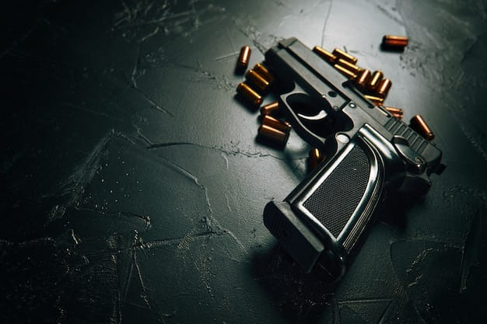
INTRODUCTION :
Guns are firearms designed to launch projectiles, typically bullets, using explosive force. They come in various types and serve multiple purposes, including sport shooting, hunting, self-defense, and military applications. Here are some key categories and concepts:

Slide 3
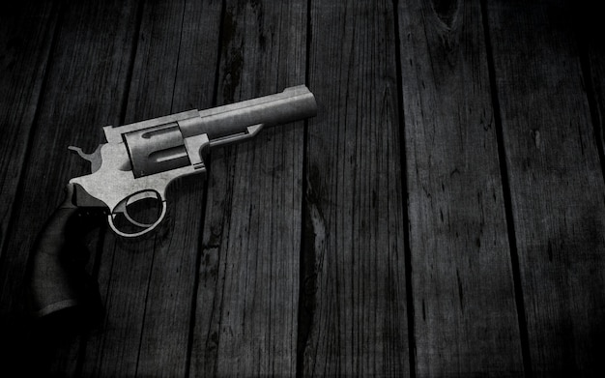
Types of Guns Handguns:
Revolvers: Have a rotating cylinder that holds cartridges. Easy to use but generally have a limited capacity.
Semi-automatic pistols: Use the energy from firing a round to automatically load the next round into the chamber.

Slide 4
Rifles:
Bolt-action: Require the shooter to manually operate the bolt to load and fire rounds.
Semi-automatic rifles: Automatically load the next round after firing, allowing for faster shooting.
Automatic rifles: Can fire continuously as long as the trigger is held down (often restricted or regulated).
Shotguns:Designed to fire multiple pellets (shot) or a single slug. Commonly used for hunting birds and for home defense.

Slide 5
Caliber: Refers to the diameter of the bullet or the internal diameter of the gun's barrel. Common calibers include .22, .38, 9mm, and .45.
Action: The mechanism that loads, fires, and ejects cartridges. Types include single-action, double-action, and lever-action.
Safety: Many guns have safety features to prevent accidental discharge.

Slide 6
Regulations
Gun laws vary widely by country and even by regions within countries. They may include:
Licensing: Some areas require permits to purchase or carry firearms.
Background checks: Many places mandate background checks before buying a gun.
Restrictions: Certain types of guns or accessories (like high-capacity magazines) may be restricted or banned.

Slide 7
THANK YOU
TEAM CRITICAL THINKERS
T.RISHIKA
K.VAISHNAVI
V.MANASWANI DEVI
V.TEJASWINI
Y.AVANTHIKA

